Slide 1
Flight delay
Team 8
Ajinkya Rode
Daniel Eichman
Sai Sakhare

Slide 2
Business use case
User will input flight information and will receive whether or not their flight will be delayed by more than 5 minutes.
Prediction delays in future flights and its secondary use cases
Help customers with their travel plans
Help the airline in arranging connecting flights
Help the airlines to make dynamic roster of flight crew

Slide 3

Goal
To create a model that predicts flight delay times
Design the model based on past trends, weather and holiday season

Slide 4
Data Source
Flight delay information released by US Department of Transportation(DOT)- http://stat-computing.org/dataexpo/2009/the-data.html
This data is for the years 1987 to 2008 and amounts to roughly 12GB (49 million records)
Used data for the year 2008 to design the model (7 million records)
Weather data-https://openweathermap.org/api
Holiday Data- Computed this data column

Slide 5
Methodology
Data Preprocessing
Removed of unwanted data
Encoded for string values using one-hot encoding
Created a function to add holiday and weather data to current data set.
Big Data Model: Neural Net
Inputs to the model: Day of Week, Origin, Dest,Holidays, Snow Origin (mm), Snow Dest (mm), Rain Origin (tenths of mm), Rain Dest (tenths of mm)
Output of the model: whether or not your flight will be delayed by more than 5 mintues
Built a simple UI so user does not have to manually enter flight data

Slide 6
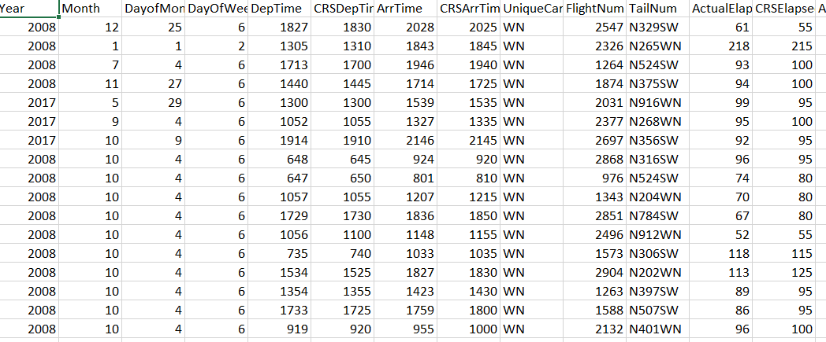
Story of the Data
Raw data has 34 independent variables
Fetched weather data from API added to CSV file
Computed Holiday parameter and added to CSV file.
Format data for machine learning

Slide 7
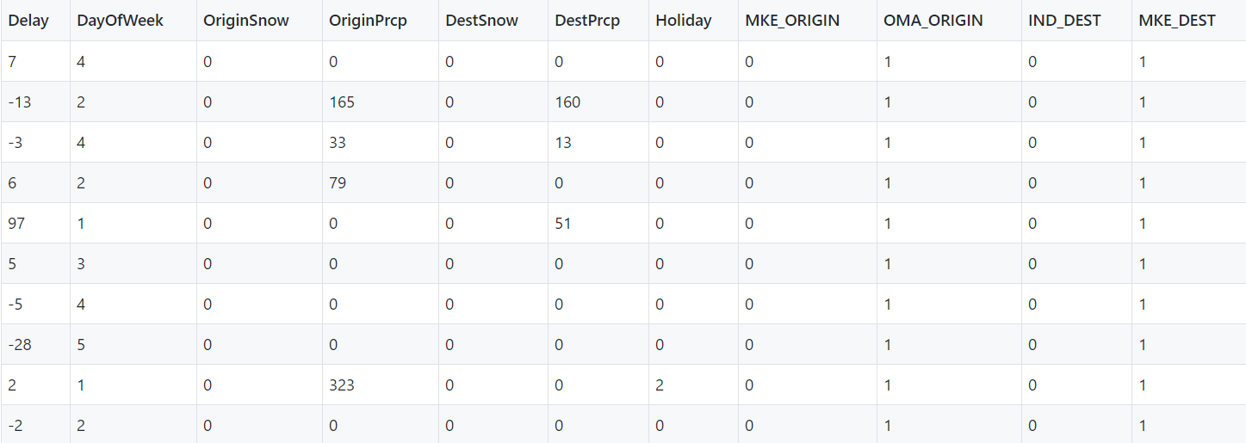
Story of the Data: Raw Data
Raw data has 34 independent variables
Kept: Day of week, Origin, Destination
Origin and Destination are represented as airport codes and this need to be changed to one’s hot encoding.

Slide 8
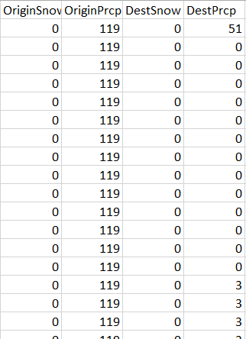
Story of the Data: Weather
Fetched weather data from API added to CSV file
Used noaa.gov’s api to collect weather data for all 7 million flights.
This took over 5 days to collect as you can only have 10,000 requests/day

Slide 9
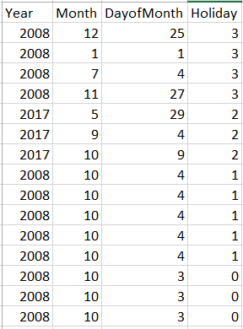
Story of the Data: Holiday
Computed Holiday parameter and added to CSV file.
Created a function, using Joda-Time, to classify any given day as a regular weekday, weekend, long weekend or a major US Holiday
Input to the function: Year, day and month from the original data
Output of the function: An integer-
0- regular weekday
1- weekend
2- long weekend
3- major US Holiday

Slide 10
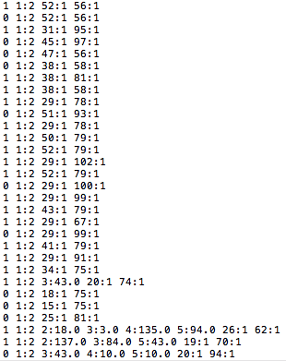
Story of the Data: Load and clean
Format data for machine learning
Change categorical data to one’s hot encoding
Only kept routes between top 100 airports
Change csv to libsvm format
Dropped a random 50% of flight data kept around 2 million records

Slide 11
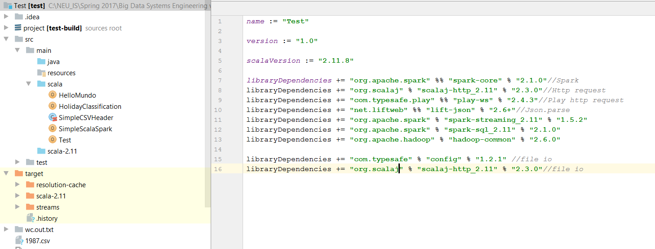
Directory Structure

Slide 12
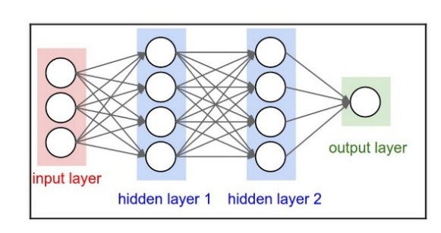
What are Neural Networks ?
Biologically inspired machine learning algorithm
Uses back propagation mechanism to train the model
Mathematical neurons arranged in layers
Accumulate signals from the previous layer

Slide 13
Model details
Split the data into 70% training data and 30% test data
Built a Classification model using NN
Number of layers and number of nodes in each layer
Input Layer: 105(number of inputs to the NN)
Hidden Layer 1: 25 nodes
Hidden Layer 2: 20 nodes
Output Layer: 2 nodes

Slide 14
Prediction
5 minute delay assumption
Delay > 5 minutes – delayed
Delay < 5 minutes – not delayed

Slide 15
Acceptance criteria
Split the data Set and calculate the Percentage accuracy of the predictive model
Achieved accuracy of 67 % in prediction in prediction of flight delay
Achieved accuracy of 98% in prediction of flight cancellations
Create model that shows based off future flight data
Chance of cancellation
Predicts if the flight will get cancelled
chance of delay begin over X minutes
Predicts chance of delay over 5 minutes ☺

Slide 16
Results
For any given flight, delay information is obtained with an accuracy of 67%
For any given flight, predicts if the flight will get cancelled with an accuracy of 98%

Slide 17
Thank you!

